Slide 1

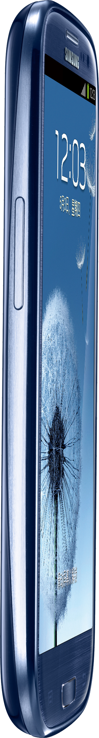



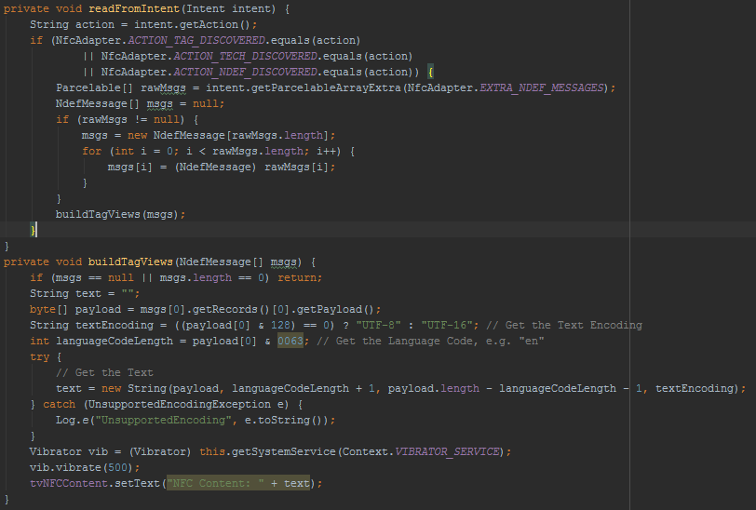
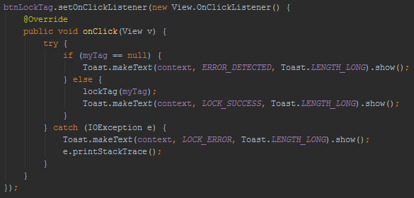
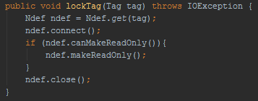
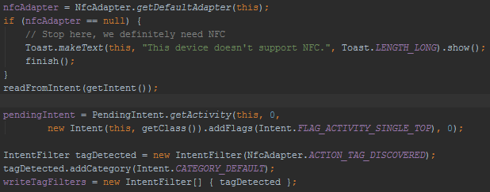





Abstract
Near Field Communication efficiently facilitates wireless, close-proximity transfer of relatively small amounts of data over a specifically defined radio frequency (13.56 MHz). Any Mobile device with integrated NFC hardware can actively generate a controlled electromagnetic field in order to stimulate an antenna, typically printed onto a thin, flat substrate referred to as a NFC “tag”. The energy transferred to the antenna is guided to an integrated circuit for processing Read/Write commands relevant to the tag’s memory module.
STATIC LOCK BYTES - Field Programmable Read-Only Locking Mechanism
MEMORY LOCATION - PAGE 02h (Hex)
DETAILS - Each bit represents an individual 16-bit page from 03h to 0Fh. Bits set to 1 permanently lock their corresponding pages as read-only.
L7 | L6 | L5 | L4 | L CC | BL 15-10 | BL 9-4 | BL CC
L 15 | L 14 | L 13 | L 12 | L 11 | L 10 | L 9 | L 8
COURSE INFORMATION
CNT 4514C: Wireless Networks and Mobile Computing
Professor Zornitza Genova Prodanoff
Spring Term 2017
NFC Tag Locking Mechanisms
Near Field Communication efficiently facilitates wireless, close-proximity transfer of relatively small amounts of data over a specifically defined radio frequency (13.56 MHz). Any Mobile device with integrated NFC hardware can actively generate a controlled electromagnetic field in order to stimulate an antenna, typically printed onto a thin, flat substrate referred to as a NFC “tag”. The energy transferred to the antenna is guided to an integrated circuit for processing Read/Write commands relevant to the tag’s memory module.
CAPABILITY CONTAINER - One Time Programmable Bits
MEMORY LOCATION - PAGE 03h
DETAILS - Writability defined by Static Lock Bytes. Stores control data for managing NFC Forum defined data inside the tag.
CONTACT
LOCK0
Christopher Small
N00931863@ospreys.unf.edu
LOCK1
E1 | 10 | 12 | 00
Magic Number | NFC Type 2 Version Number | Data Area (144 Bytes) | R/W Access (No Security)
Abstract
OTP1
DYNAMIC LOCK BYTES - Position Based Locking
MEMORY LOCATION - DYNAMIC
DETAILS - Used to lock discrete memory blocks after PAGE 15h.
OTP0
OTP2
OTP3
LOCK2
LOCK3
LOCK4
04 34 CB 73 2A 74 40 81 9F 48 00 00 E1 10 12 00 01 03 A0 0C 34 03 00 FE 00 00 00 00 00 00 00 00 00 00 00 00 00 00 00 00 00 00 00 00 00 00 00 00 00 00 00 00 00 00 00 00 00 00 00 00 00 00 00 00 00 00 00 00 00 00 00 00 00 00 00 00 00 00 00 00 00 00 00 00 00 00 00 00 00 00 00 00 00 00 00 00 00 00 00 00 00 00 00 00 00 00 00 00 00 00 00 00 00 00 00 00 00 00 00 00 00 00 00 00 00 00 00 00 00 00 00 00 00 00 00 00 00 00 00 00 00 00 00 00 00 00 00 00 00 00 00 00 00 00 00 00 00 00 00 00 00 00 00 BD 04 00 00 FF 00 05 -- -- FF FF FF FF 00 00 -- --
NEAR FIELD COMMUNICATION
04 34 CB 73 2A 74 40 81 9F 48 F8 FF E1 10 12 0F 01 03 A0 0C 34 03 3A 91 01 08 54 02 65 6E 53 54 41 52 54 54 0F 1C 61 6E 64 72 6F 69 64 2E 63 6F 6D 3A 70 6B 67 63 6E 74 34 35 31 34 63 2E 75 6E 66 73 79 6D 70 6F 73 69 75 6D 6E 66 63 71 75 69 7A FE 00 00 00 00 00 00 00 00 00 00 00 00 00 00 00 00 00 00 00 00 00 00 00 00 00 00 00 00 00 00 00 00 00 00 00 00 00 00 00 00 00 00 00 00 00 00 00 00 00 00 00 00 00 00 00 00 00 00 00 00 00 00 00 00 00 00 00 00 00 00 00 00 00 00 00 00 00 00 FF 01 00 BD 04 00 00 FF 00 05 -- -- FF FF FF FF 00 00 -- --
OTP0
OTP1
LOCK1
OTP2
OTP3
LOCK0
LOCK3
NDEF
Near Field Communication efficiently facilitates wireless, close-proximity transfer of relatively small amounts of data over a specifically defined radio frequency (13.56 MHz). Any Mobile device with integrated NFC hardware can actively generate a controlled electromagnetic field in order to stimulate an antenna, typically printed onto a thin, flat substrate referred to as a NFC “tag”. The energy transferred to the antenna is guided to an integrated circuit for processing Read/Write commands relevant to the tag’s memory module.
LOCK2
LOCK4
Near Field Communication efficiently facilitates wireless, close-proximity transfer of relatively small amounts of data over a specifically defined radio frequency (13.56 MHz). Any Mobile device with integrated NFC hardware can actively generate a controlled electromagnetic field in order to stimulate an antenna, typically printed onto a thin, flat substrate referred to as a NFC “tag”. The energy transferred to the antenna is guided to an integrated circuit for processing Read/Write commands relevant to the tag’s memory module.
Summary
Near Field Communication efficiently facilitates wireless, close-proximity transfer of relatively small amounts of data over a specifically defined radio frequency (13.56 MHz). Any Mobile device with integrated NFC hardware can actively generate a controlled electromagnetic field in order to stimulate an antenna, typically printed onto a thin, flat substrate referred to as a NFC “tag”. The energy transferred to the antenna is guided to an integrated circuit for processing Read/Write commands relevant to the tag’s memory module.
LOCKED
Near Field Communication efficiently facilitates wireless, close-proximity transfer of relatively small amounts of data over a specifically defined radio frequency (13.56 MHz). Any Mobile device with integrated NFC hardware can actively generate a controlled electromagnetic field in order to stimulate an antenna, typically printed onto a thin, flat substrate referred to as a NFC “tag”. The energy transferred to the antenna is guided to an integrated circuit for processing Read/Write commands relevant to the tag’s memory module.
Choosing Android as a Development Platform
Though NFC technology and protocols were designed to be software agnostic, Google’s Android Operating System provides more freedom for software developers to take advantage of NFC hardware. The mobile application presented here supports APIs version 19 (KitKat) and older.
REFERENCES
M. Roland and J. Langer, "Digital Signature Records for the NFC Data Exchange Format," 2010 Second International Workshop on Near Field Communication, Monaco, 2010, pp. 71-76. doi: 10.1109/NFC.2010.10
B. Jepson, D. Coleman, and T. Igoe, 4. Introducing NDEF [Book]. Safari, 2017. [Online]. Available: https://www.safaribooksonline.com/library/view/beginning-nfc/9781449324094/ch04.html. Accessed: Feb. 2, 2017.
NFC, Forum. "NFC Forum Technical Specifications Improve RF Communication and NFC Tag Interoperability with NFC Devices." Business Wire (English) Dec. 0010: Regional Business News. Web. 1 Feb. 2017.
electrical 4 u, "Air core transformer," 2011. [Online]. Available: http://www.electrical4u.com/air-core-transformer/. Accessed: Feb. 1, 2017.
NFC Forum, 1st ed. NFC Data Exchange Format (NDEF) Technical Specification, 1st ed. Wakefield, MA: NFC Forum, 2006. Web. 27 Mar. 2017.

